Slide 1

Project Proposal
Table of content
01
The Problem
06
Project Management Strategy
02
The Solution
07
Project requirement
03
Goals and benefits
08
Project Proposal Timeline
04
Deliverables of the project
09
Conclusion
05
Success Criteria
10
Thank You
Project name : “Your Feedback, Our Future”
Prepared for :
Dr. Rami ibrahim
Thierry Marigny (CEO)
Prepared by: Yousef Abu ALI

Slide 2
Table of content
01
The Problem
06
Project Management Strategy
02
The Solution
07
Project requirement
03
Goals and benefits
08
Project Proposal Timeline
04
Deliverables of the project
09
Conclusion
05
Success Criteria
10
Thank You

Slide 3

The Problem
Telecommunication companies such as orange Jordan are struggling with the huge amount of customer complaints Everyday. And such companies would risk customer retention and bad reputation if these complaints weren't resolved effectively.

Slide 4

The Solution
To solve this problem, I aim to build a big data system for orange Jordan. The system’s main goal is to use data mining techniques to gain valuable insights by focusing on customer behavior, suggestions, and complaints to produce ideas that would help in improving orange’s product and services.

Slide 5






Goals and benefits
Goals
Benefits
Understanding customers
Preferences, concerns, and sentiments
Improving products and services
Enhancing quality from customer feedback
Real-Time Ideas
Transforming comments into Ideas
Competitive advantage
Helping Orange Jordan to lead the telecommunication industry
Churn Prediction
Identify customers at risk for targeted effort
Customer satisfaction and Loyalty
Providing better customer experience and having their loyalty

Slide 6
Success criteria
Deliverables of the project
Number of Successful Product or Service Improvements
Big data platform that performs operations (store, process, and analyze customer data) as well as Documentation and training material
Impact on Business Metrics (e.g., revenue)
A dashboard for user interface that would provide users with accessibility to the outputs, visualizations, and tools that would help in managing insights
Reduction in Customer Complaints or Negative Feedback
Application interface that's integrated with current systems to ease the exchange between new big data system and the other platforms for the organization
Quality of Ideas Generated
Model that predicts customer churn and segmentation, to generate insights and recommendation

Slide 7
Success criteria
Deliverables of the project
Quality of Ideas Generated
Model that predicts customer churn and segmentation, to generate insights and recommendation
Reduction in Customer Complaints or Negative Feedback
Application interface that's integrated with current systems to ease the exchange between new big data system and the other platforms for the organization
Impact on Business Metrics (e.g., revenue)
A dashboard for user interface that would provide users with accessibility to the outputs, visualizations, and tools that would help in managing insights
Number of Successful Product or Service Improvements
Big data platform that performs operations (store, process, and analyze customer data) as well as Documentation and training material

Slide 8
Project Management Strategy
Budget
WBS Dictionary
Stakeholder matrix
Risk management plan
This project involved the use of waterfall methodology. It provided clear structure and planed timeline.
Software setup
Testing, Validation, and Improvment
Infrastructure
setup
System design
Data Collection, preparation
Deployment
Monitoring
Implementation
Data analysis
Model Development
Training
Project Scope
Critical path
Quality management
plan
Project charter

Slide 9
Project Management Strategy
This project involved the use of waterfall methodology. It provided clear structure and planed timeline.
During my project I prepared Information on several important aspects:
Testing, Validation, and Improvment
Project charter
Budget
WBS Dictionary
Project Scope
System design
Implementation
Deployment
Monitoring
Risk management plan
Critical path
Quality management
plan
Stakeholder matrix
Training
Software setup
Infrastructure
setup
Data Collection, preparation
Data analysis
Model Development

Slide 10

Project charter
Project charter
Project Objectives: Included the goals we want to reach from employing this project.
Understanding customers
Improve productivity
Customer satisfaction
Deliverables: the project results (output) that will be used after the project ends
Platform
Model
Application
Business Case: Showing the reason behind the project, including it’s purpose, and benefits as well as understanding the company and their operation to connect the project with the business.
Understanding their problems
Understanding their current approach
Mentioning the benefits of the project for the company
Scope and Exclusion:
In scope: (Training, setting up hardware and software, Developing model and integration)
Out of scope: ( hardware maintenance, electrical setup, extended software features beyond the agreed on)
Project Team: The project team included all the stakeholders related to this project.
Project sponsor: CEO
Project lead: Project manager
Project team: trainer, designer, developer
Additional stakeholders: external consultant, security experts, customers.
Project charter

Slide 11
Project charter
Project charter
Project Objectives: Included the goals we want to reach from employing this project.
Understanding customers
Improve productivity
Customer satisfaction
Deliverables: the project results (output) that will be used after the project ends
Platform
Model
Application
Business Case: Showing the reason behind the project, including it’s purpose, and benefits as well as understanding the company and their operation to connect the project with the business.
Understanding their problems
Understanding their current approach
Mentioning the benefits of the project for the company
Scope and Exclusion:
In scope: (Training, setting up hardware and software, Developing model and integration)
Out of scope: ( hardware maintenance, electrical setup, extended software features beyond the agreed on)
Project Team: The project team included all the stakeholders related to this project.
Project sponsor: CEO
Project lead: Project manager
Project team: trainer, designer, developer
Additional stakeholders: external consultant, security experts, customers.

Slide 12
Project Management Strategy
Project charter
Budget
WBS Dictionary
Project Scope
Risk management plan
Critical path
Quality management
plan
Stakeholder matrix

Slide 13
Project Scope

Slide 14
Project Scope
Project Scope
1. PROJECT OBJECTIVE:
Understanding customer preferences, concerns, and feelings about their products and services.
The ability to transform customer comments into real-time ideas, which would help the organization to improve their products and services continuously.
2. PROJECT DELIVERABLES:
Big data platform that performs operations (store, process, and analyze customer data).
A dashboard for user interface that would provide users with accessibility to the outputs, visualizations, and tools that would help in managing insights.
3. PROJECT MILESTONES:
Milestone 1( System design and security): complete the design of the system and the security plan(Jan 14, 2024)
Milestone 2 (software): Complete software preparation “Download and setup” (Jan 29, 2024)
Milestone 3 (infrastructure): Complete setting up the hardware and software (Feb 21, 2024)
4. PROJECT TECHNICAL REQUIREMENTS:
Employee system functionalities
System functionalities
Customer feedback platform functionalities

Slide 15
Project Management Strategy
Project charter
Budget
WBS Dictionary
Project Scope
Risk management plan
Critical path
Quality management
plan
Stakeholder matrix

Slide 16
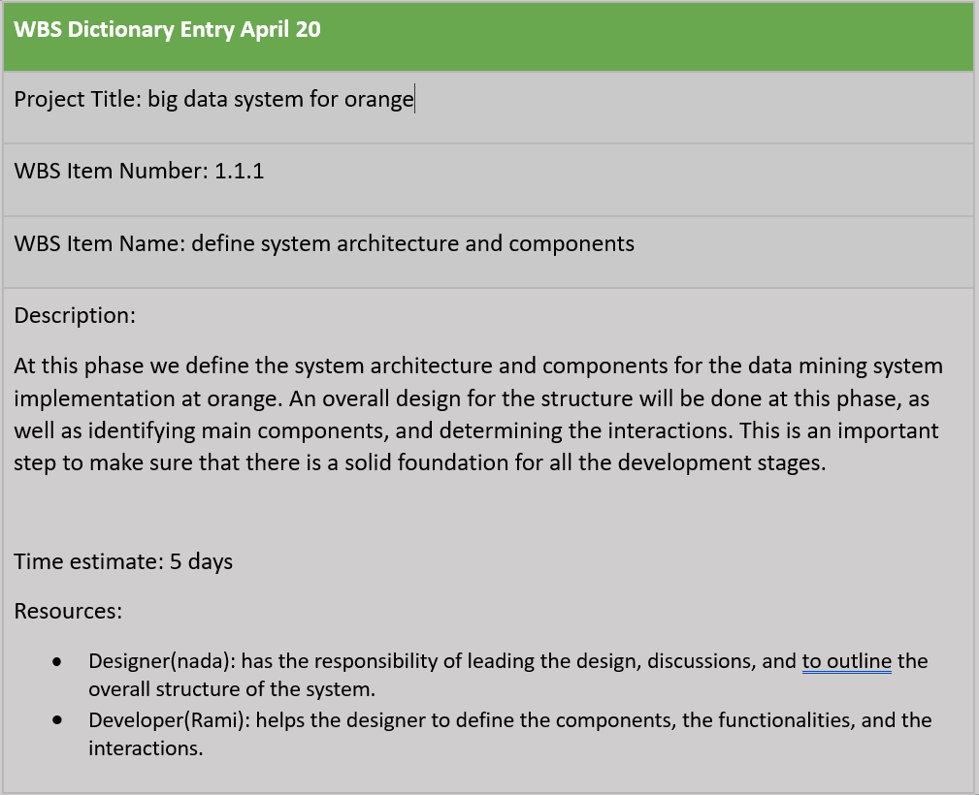
WBS dictionary
WBS Dictionary
The WBS dictionary is a break down for the elements of the WBS. It shows the following details:
Project title
WBS item number
WBS item name
Description of the element
The time estimation of the WBS element
The resources needed to complete the tasks

Slide 17
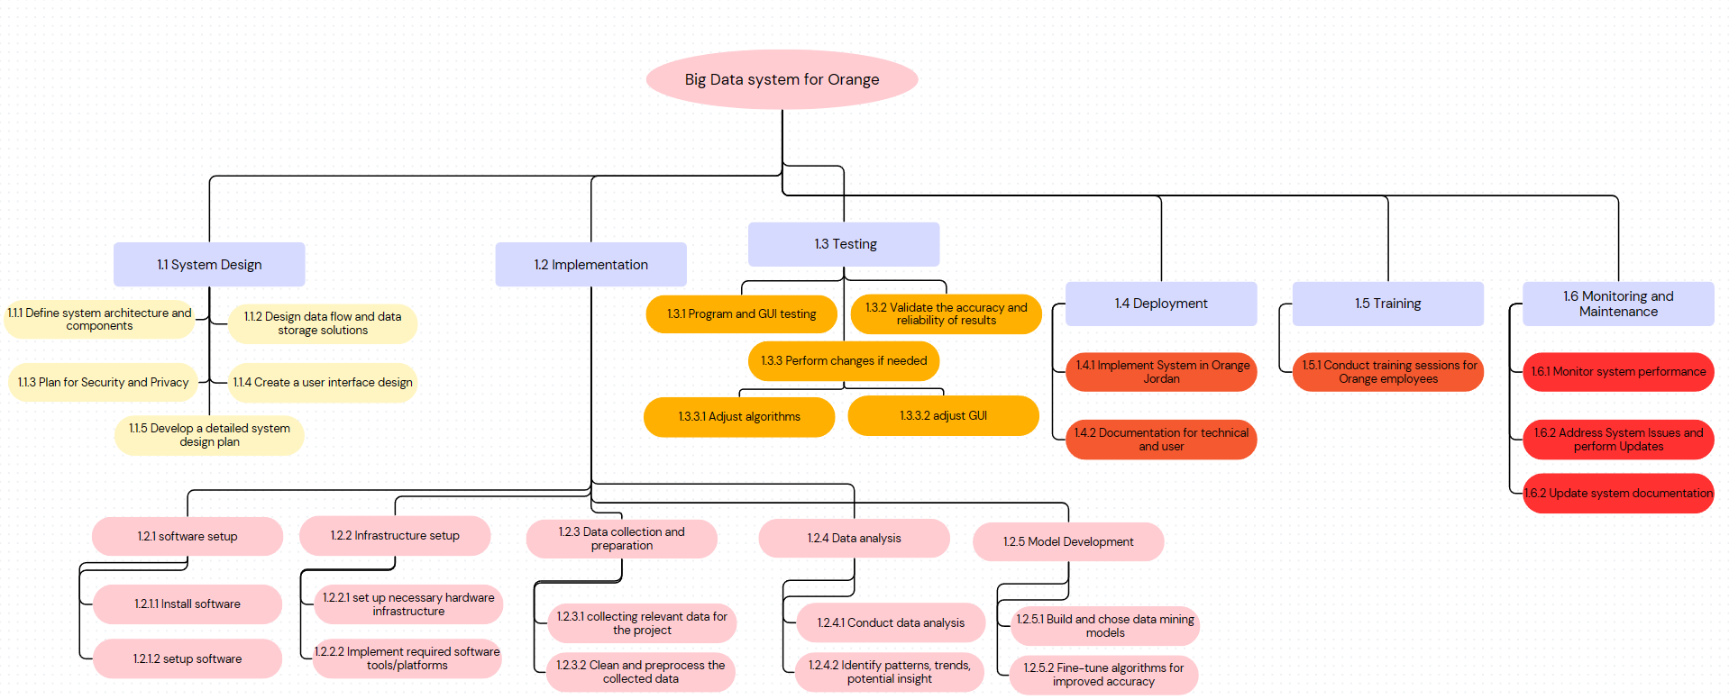
WBS dictionary
WBS Dictionary
The WBS dictionary is a break down for the elements of the WBS. It shows the following details:
Project title
WBS item number
WBS item name
Description of the element
The time estimation of the WBS element
The resources needed to complete the tasks

Slide 18
WBS dictionary
WBS Dictionary
The WBS dictionary is a break down for the elements of the WBS. It shows the following details:
Project title
WBS item number
WBS item name
Description of the element
The time estimation of the WBS element
The resources needed to complete the tasks

Slide 19
Project Management Strategy
Project charter
Budget
WBS Dictionary
Project Scope
Risk management plan
Critical path
Quality management
plan
Stakeholder matrix

Slide 20
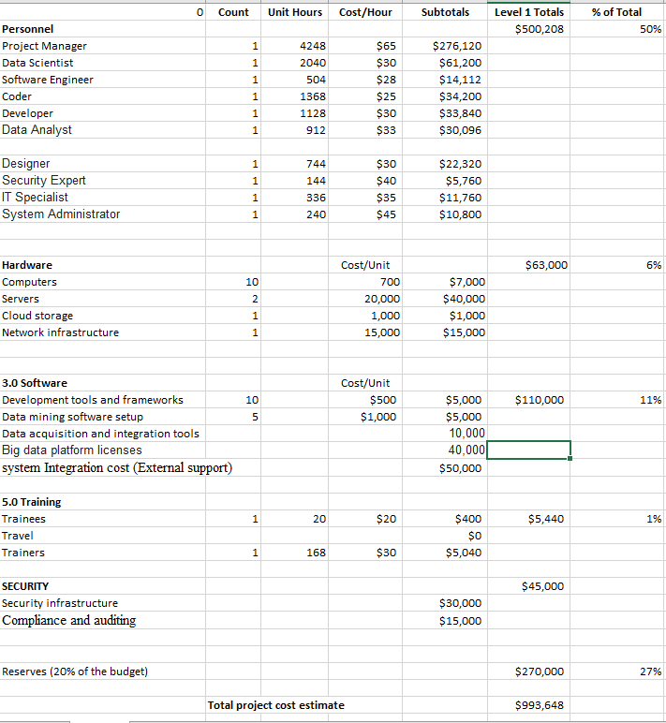

Budget
Budget
Budget
In the budget assumption table, I have mapped out the financial aspects of the big data project at orange. It includes building a secure system, obtaining the data, analyzing it, and employing it. I have accounted the salaries, hardware, software, training, and reserved some of the total budget just in case. By that, everyone knows where the money is being spent on.

Slide 21
Budget
Budget
In the budget assumption table, I have mapped out the financial aspects of the big data project at orange. It includes building a secure system, obtaining the data, analyzing it, and employing it. I have accounted the salaries, hardware, software, training, and reserved some of the total budget just in case. By that, everyone knows where the money is being spent on.

Slide 22
Project Management Strategy
Project charter
Budget
WBS Dictionary
Project Scope
Risk management plan
Critical path
Quality management
plan
Stakeholder matrix

Slide 23
Critical Path
Critical path

Slide 24
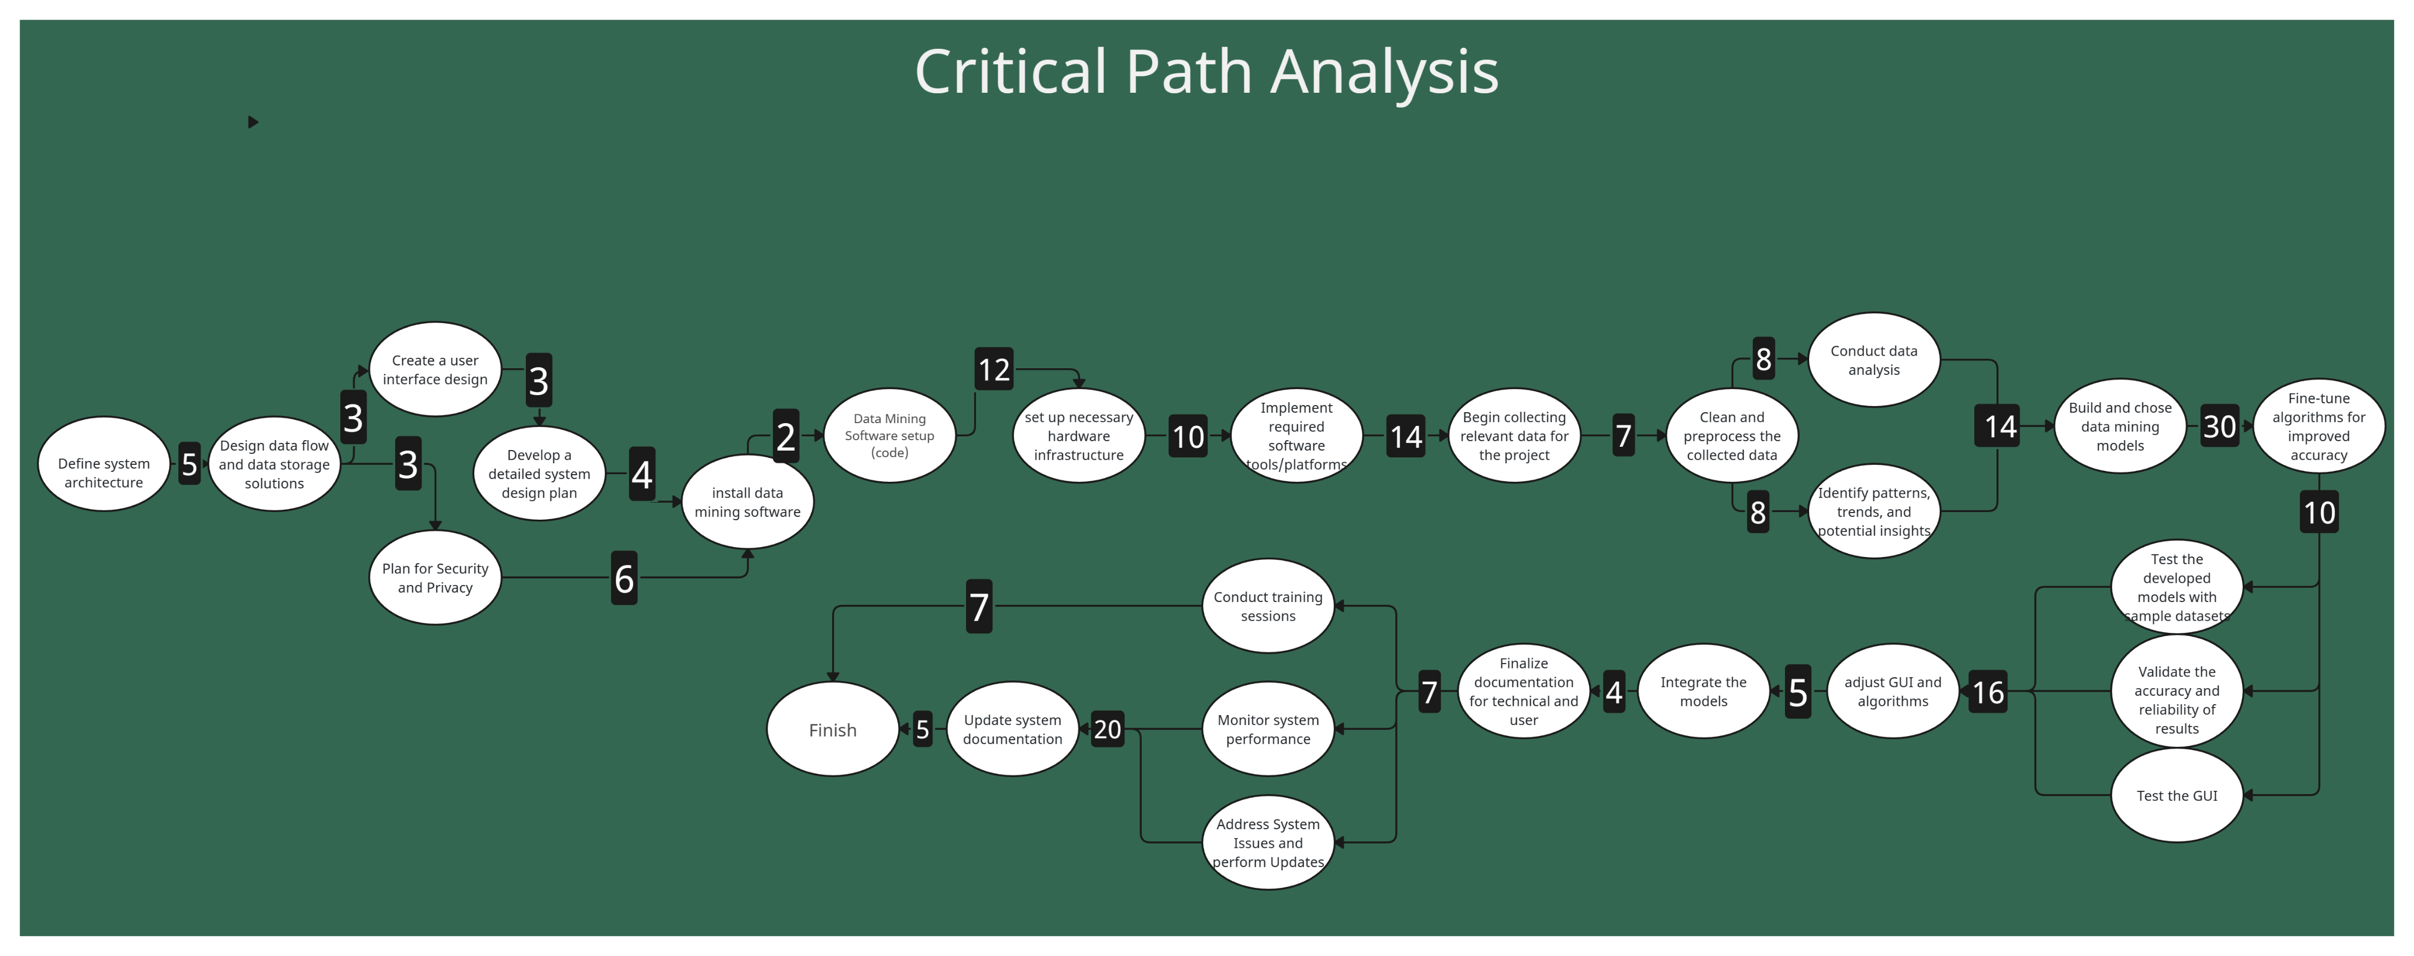
The critical path is the longest sequence of important tasks that must be completed on time for the entire project to be finished on the time specified. Any delays in any of the tasks in the critical path will directly impact the project timeline, while delays in the non-critical tasks will not affect the end date. Critical path = 5 + 3 + 3 + 4 + 2 + 12 + 10 + 14 +7 + 8 + 14 + 30 + 10 + 16 + 5+ 4 + 7 +20 + 5 = 179 days Other path = 5 +3 + 6 +2 + 12 + 10 + 14 + 7 + 8 + 14 + 30 + 10 + 16 + 5 + 4 + 7 + 7 = 160 days
Critical path

Slide 25
Project Management Strategy
Project charter
Budget
WBS Dictionary
Project Scope
Risk management plan
Critical path
Quality management
plan
Stakeholder matrix

Slide 26
Stakeholder matrix
Stakeholder matrix

Slide 27
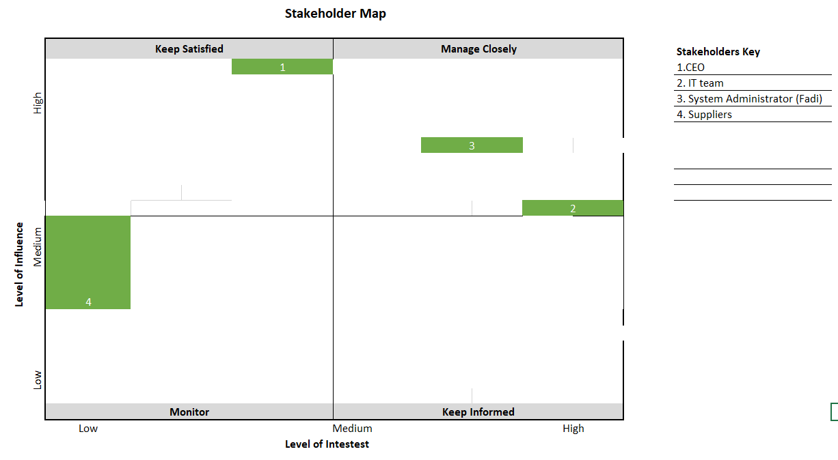
Stakeholder matrix A tool used to categorize stake holders based on their interest and influence on a project. It helps in knowing how to deal with each stakeholder.
Stakeholder matrix

Slide 28
Project Management Strategy
Project charter
Budget
WBS Dictionary
Project Scope
Communication management plan
Risk management plan
Critical path
Quality management
plan
Stakeholder matrix

Slide 29
Project Management Strategy
Project charter
WBS Dictionary
Project Scope
Budget
Stakeholder matrix
Communication management plan
Quality management
plan
Risk management plan
Critical path

Slide 30
Communication management plan

Slide 31
Communication Management Plan
Communication management plan
Sender/Owner | Stakeholder/Recepient | Delivery Medium | Delivery Method | Frequency | Goal
Project Manager | CEO (Thierry Marigny) | Email/ Meetings | Formal | weekly | Keeping the CEO Informed about the project Progress/ Get Input on Important decisions
Project Manager | IT Team | Meetings/Email/Verbal | Formal/Informal | Daily | Communiacting roles, respnsibilites, and dedlines.
Project Manager | System Administrator | Meetings | Formal | weekly | getting information on project milestones, system health
Project Manager | Suppliers | Verbal (Phone) | Informal | Daily | Communicate Material requirements when needed/Keep Monitoring for future material
IT Team | Project Manager | Email | Formal | As needed | Sharing progrees, challenges, needs and insights
System Administrator | Project Manager | Meetings/Email | Formal | As needed | Keeping the Manager Informed about Project Progress/ Get Input on Important decisions
IT Team | System Administrator | Meetings/Email/Verbal | Formal/Informal | Daily | Engaging in discussions to address potential issues in the system
Suppliers | Project Manager | Verbal (Phone) | Informal | Daily | Communicate availability of materials and address issues related to supply chain

Slide 32
Project Management Strategy
WBS Dictionary
Budget
Project charter
Project Scope
Stakeholder matrix
Communication management plan
Risk management plan
Critical path
Quality management
plan

Slide 33
Project Management Strategy
Project charter
Budget
WBS Dictionary
Project Scope
Communication management plan
Risk management plan
Critical path
Quality management
plan
Stakeholder matrix

Slide 34
Risk management plan
Risk management plan

Slide 35
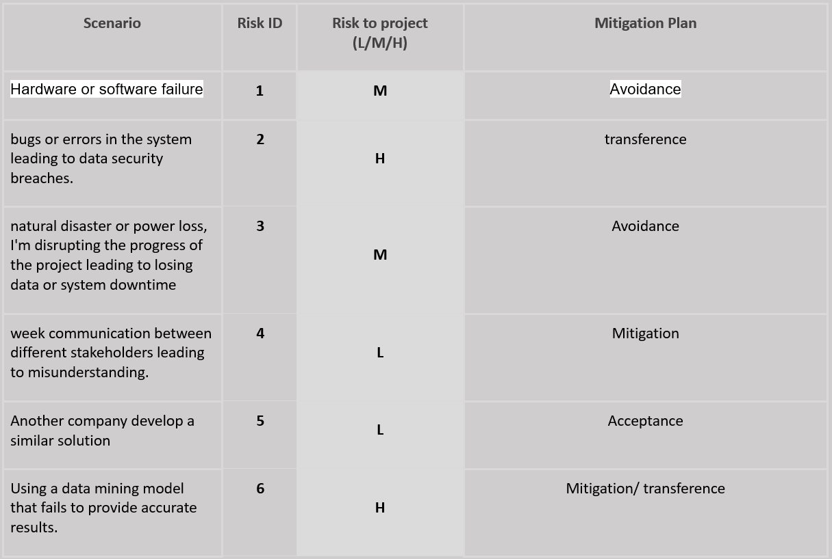
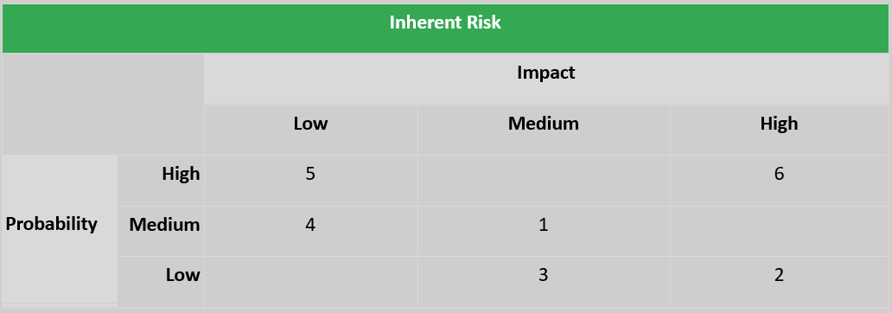
Risk management plan
Risk management plan
Risk management plan is a structured approach that we use to Identify, access, prioritize, and mitigate the risks in a project. By that we clearly identify any issues that would prevent us from achieving our goals.

Slide 36
Project Management Strategy
Project charter
Budget
WBS Dictionary
Project Scope
Risk management plan
Critical path
Quality management
plan
Stakeholder matrix

Slide 37
Quality management
plan

Slide 38
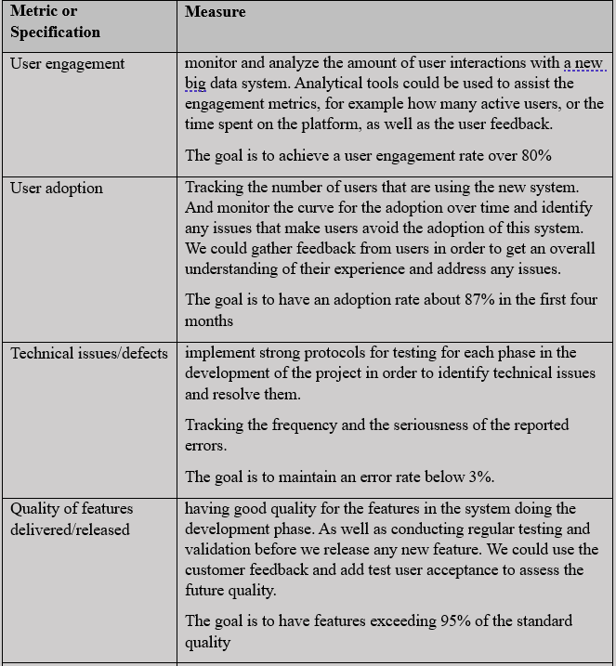
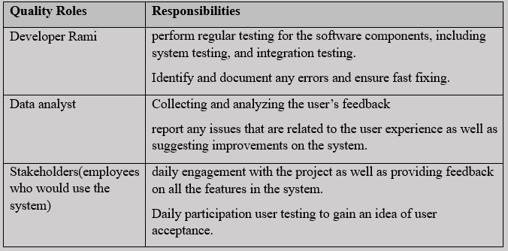
Quality management
plan
Quality management plan
Quality management is important for the success of any project, it helps in ensuring that the deliverables are met or exceed the wanted standards for the best, as well as the stakeholder expectation

Slide 39
Project Management Strategy
Project requirement
Project charter
Budget
WBS Dictionary
Project Scope
Risk management plan
Critical path
Quality management
plan
Stakeholder matrix

Slide 40
Project requirement

Slide 41
Project requirement
The work breakdown structure (WBS) chose the project requirement by clearly breaking down the tasks
1–14 Jan.
System design
14–29 Jan.
Software
29 Jan. – 21 Feb.
Infrastructure Setup
22 Feb. – 7 Mar.
Data Collection
8–21 Mar.
Initial Data analysis
22 Mar. – 30 Apr.
Model Development
1–21 May
Testing and validation
22 May – 1 June
Deployment
2–8 June
Training
2–25 June
Monitoring and Optimization

Slide 42
Project Proposal Timeline
Project requirement
1–14 Jan.
System design
14–29 Jan.
Software
29 Jan. – 21 Feb.
Infrastructure Setup
22 Feb. – 7 Mar.
Data Collection
8–21 Mar.
Initial Data analysis
22 Mar. – 30 Apr.
Model Development
1–21 May
Testing and validation
22 May – 1 June
Deployment
2–8 June
Training
2–25 June
Monitoring and Optimization

Slide 43


Conclusion
Project Proposal Timeline
In conclusion this project aims to build a big data project for orange Jordan using advanced data mining technology. The system main functionality (goal) is to transform client’s comments and feedbacks that are gathered from multiple sources, into beneficial insights and ideas that would help in maintaining a continuous improvement and innovation for the products and services at orange Jordan.
This all was the planning phase and next I will hold a kickoff meeting with my team members to start working on the project.
1–14 Jan.
System design
14–29 Jan.
Software
29 Jan. – 21 Feb.
Infrastructure Setup
22 Feb. – 7 Mar.
Data Collection
8–21 Mar.
Initial Data analysis
22 Mar. – 30 Apr.
Model Development
1–21 May
Testing and validation
22 May – 1 June
Deployment
2–8 June
Training
2–25 June
Monitoring and Optimization

Slide 44
Thank you !

